Slide 1

Basic course6-Voice alarm
Yahboom
Yahboom OMIBOX Tutorial

Slide 2
1
2
3
4
5
Learning
goals
Search for
blocks
Combine
blocks
Experimental
phenomena
Preparation
程序编程
Tencent
Yahboom OMIBOX Tutorial

Slide 3
1
Preparation-1
1. The position of the MIC in the robot car
2. Learn how to use MIC graphically program building blocks
Yahboom OMIBOX Tutorial

Slide 4
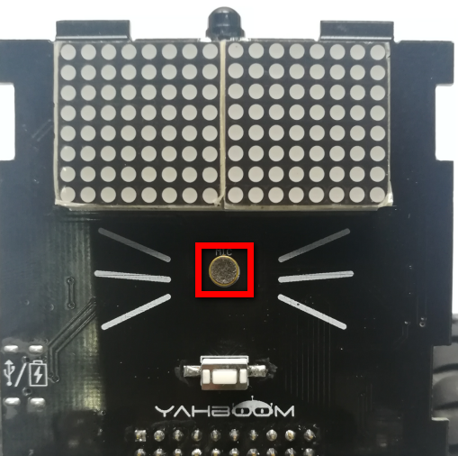
1
Preparation-2
As shown in the figure above, we circled the red wire frame with the MIC, and we can use it by programming.
Yahboom OMIBOX Tutorial

Slide 5
2
Learning goals
In this lesson, we will learn how to use the MIC. When the sound intensity reaches the corresponding value, the buzzer will sound and alarm.
Yahboom OMIBOX Tutorial

Slide 6
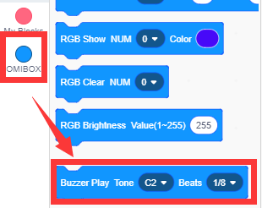
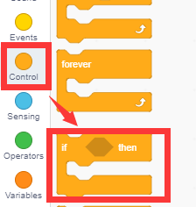
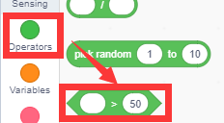
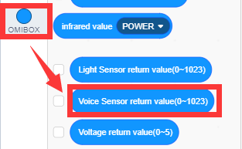
3
Search for blocks
The following is the location of the building blocks required for this programming.
Yahboom OMIBOX Tutorial

Slide 7
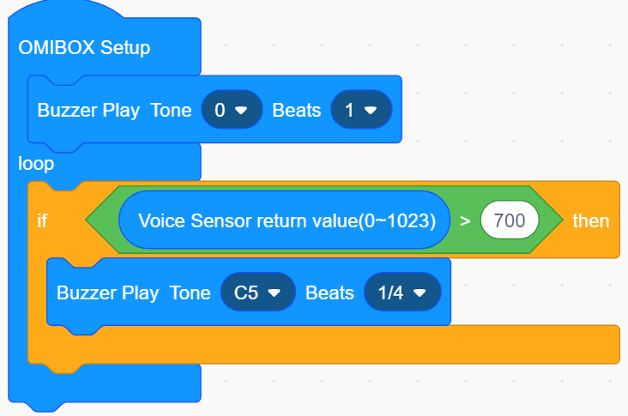
4
Combine blocks
The summary program is shown below:
Yahboom OMIBOX Tutorial

Slide 8
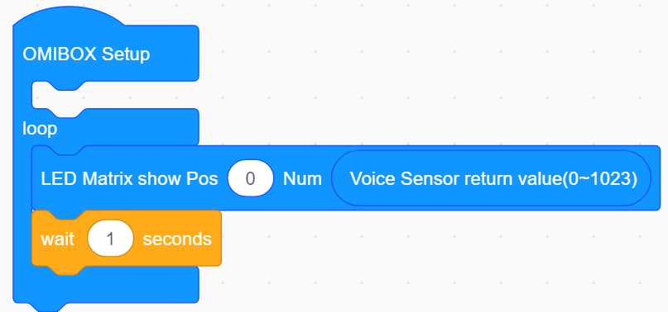
4
Combine blocks
You can get the output value of the MIC in the current environment and modify the parameters in the program as follows.
1.Write the program shown below to display the value of the sound sensor output on the dot matrix.
Yahboom OMIBOX Tutorial

Slide 9
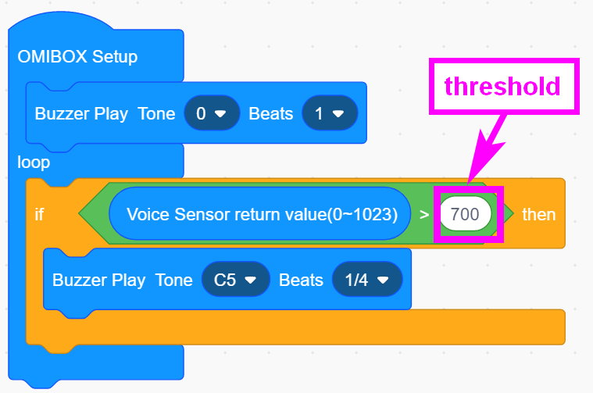
4
Combine blocks
2. Record the value A1 displayed on the dot matrix in a quiet environment, then make the Omibox in a noisy environment, or take a breath at the sound sensor of the Omibox, observe and record the value A2 displayed on the dot matrix.
3.The threshold is a value in the middle of A1, A2.
Yahboom OMIBOX Tutorial

Slide 10

5
Experimental phenomena
After the program is uploaded, opem the power of the car, the buzzer of the car will not make a sound. When we breathe a breath at the sound sensor, the buzzer will make a sound.
This experiment needs to be carried out in a quiet environment to reduce surrounding environment interferes with the sound sensor.
Yahboom OMIBOX Tutorial

Slide 11
Inspire Creativity Embrace Innovation
Thank you!!!
Yahboom

